Slide 1
Task Scheduling among Geographically Distributed Datacenters with Max-min Fairness
Wendi Chen Wenhao Chen Haoyi You
Department of Computer Science, Shanghai Jiao Tong University, Shanghai, China
May 30, 2021

Slide 2

01
02
03
04
Definition and Assumption
NP-Completeness and Proof
Model
Performance Analysis

Slide 3

Definition and Assumption
01
Problem Introduction and Challenges
Problem Definition and Assumption
Problem Formulation

Slide 4
Problem Introduction
Nowadays, there are countless bytes of data generated every second. We need to design a strategy to schedule data-analytic jobs to minimize the overall run time with max-min fairness.

Slide 5
Problem Introduction
Job Layer
Multiple parallel jobs
Shared datacenters
Stage Layer
Precedence constraints
Data reliance
Task Layer
Dependency-free

Slide 6
Challenges
Multi-stage
Network Structure
Previous one influences later one
1
2
not necessarily fully-connected
limited bandwidth
Max-min fairness
Limited Slots
4
3
Contradictory optimization objectives
some tasks may have to wait
Some slots may be idle

Slide 7
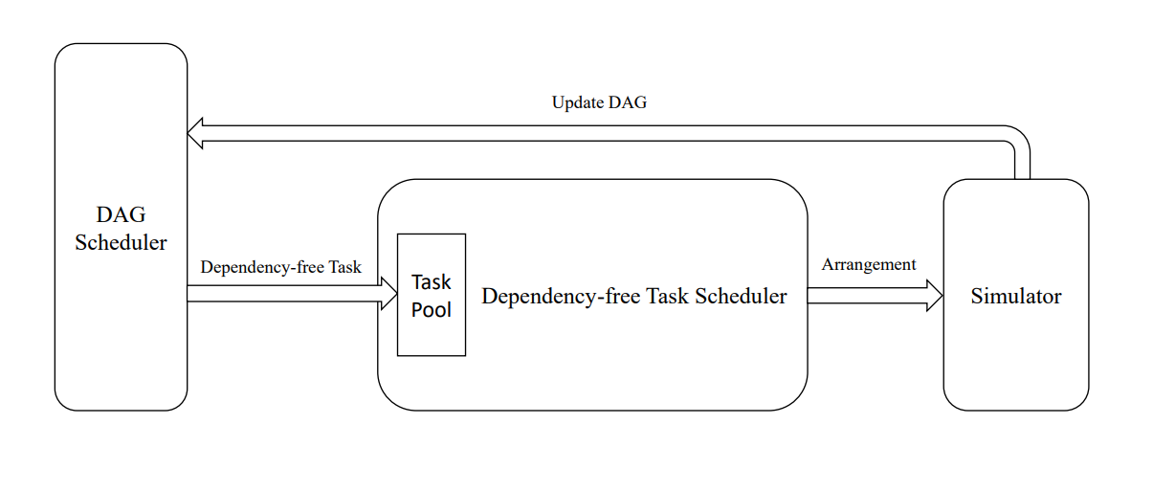
Model Flowchart (Solutions to Challenge 1)

Slide 8
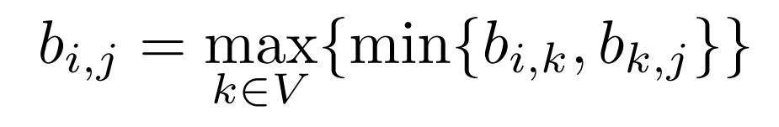
Assumptions (Solutions to Challenges 2-3)
The bandwidth between different DC should not differ too much.
Use path to connect unconnected DCs. The bandwidth is the lowest bandwidth along the path. (Floyd here)
Bandwidths are independent to tasks.

Slide 9
Definition of Max-min (Solutions to Challenge 4)
Find an arrangement strategy to minimize the completion time of the slowest task.
Do the relaxation.
Find an arrangement strategy to minimize the completion time of the second slowest task.
Repeat the above process until all tasks are minimized or relaxed.

Slide 10
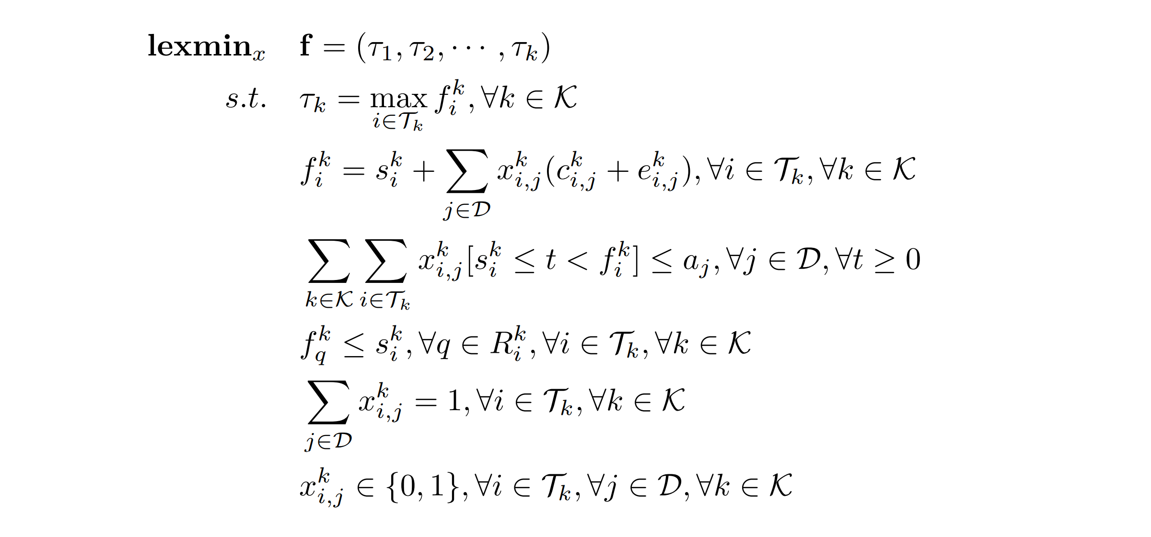
Formulation of The Original Problem

Slide 11
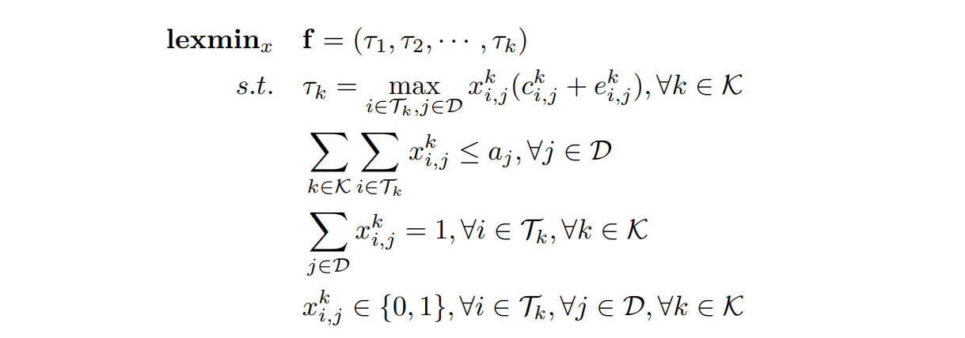
Formulation of The Sub-problem

Slide 12
Assumptions for Data Generator
80% short jobs and 20% long jobs
Distribution is similar to toy data
Links are the same as these in toy data

Slide 13
NP-Completeness and Proof
02

Slide 14
New problem definition
Problem 1
Problem 2
Problem 3
Single Execution Time Scheduling：
Single Execution Time Scheduling with variable number of processors:
$3−SAT$problem
添加观点3：
请在此输入文字说明
请在此输入文字说明
请在此输入文字说明
请在此输入文字说明
请在此输入文字说明。
Tasks $n$
Processors $k$
Tasks partial order $≺$
Time limitation $t$
Each task executes a unit time
Tasks $n$
Processors $c_{i}$ at time $i$
Tasks partial order $≺$
Time limitation $t$
Each task executes a unit time
$∑_{i=0}^{t−1}c_{i}=n$
is known as an NP-Complete problem

Slide 15
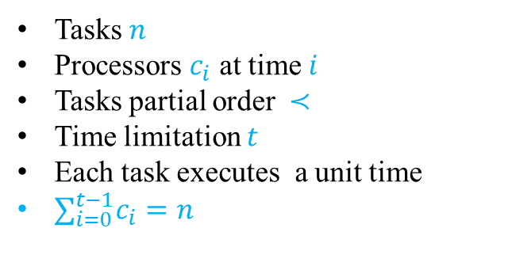
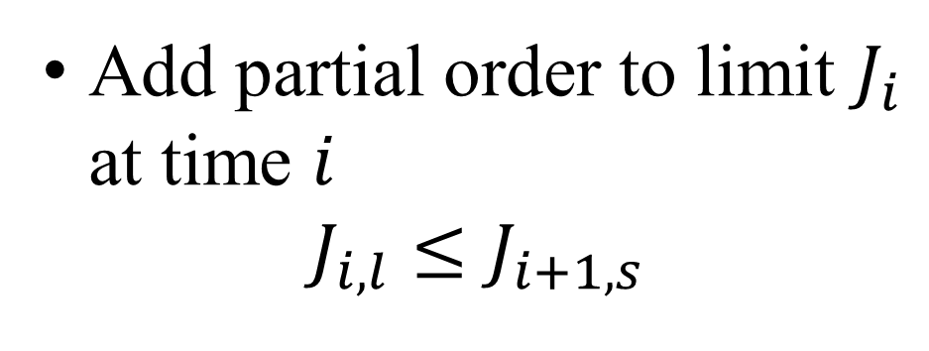
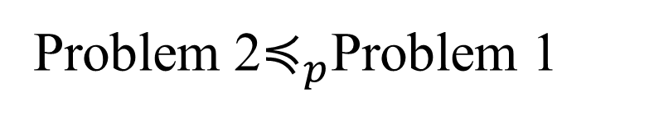
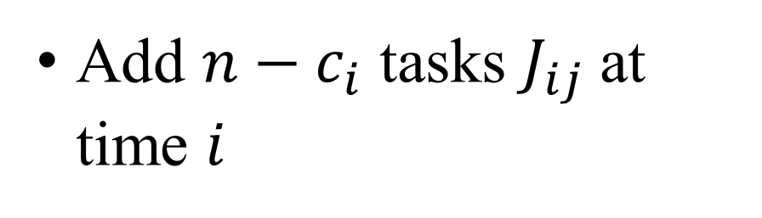
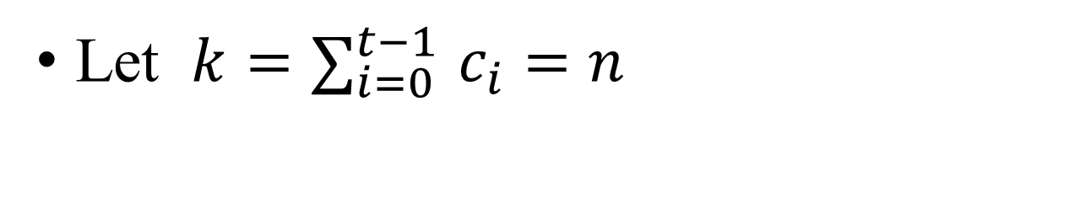
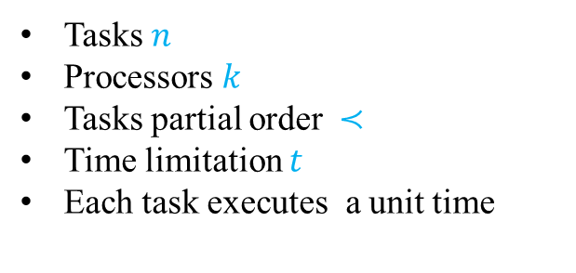
Problem Relationship
Problem 2$≼_{p}$Problem 1
Let $k{=∑}_{i=0}^{t−1}c_{i}=n$
Problem 1
Tasks $n$
Processors $k$
Tasks partial order $≺$
Time limitation $t$
Each task executes a unit time
Add $n−c_{i}$ tasks $J_{ij}$at time $i$
Problem 2
Tasks $n$
Processors $c_{i}$ at time $i$
Tasks partial order $≺$
Time limitation $t$
Each task executes a unit time
$∑_{i=0}^{t−1}c_{i}=n$
Add partial order to limit $J_{i}$ at time $i$
$$J_{i,l}≤J_{i+1,s}$$

Slide 16
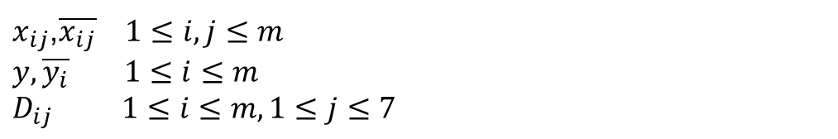
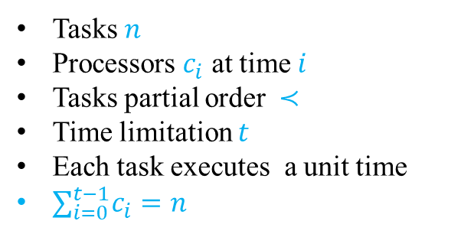
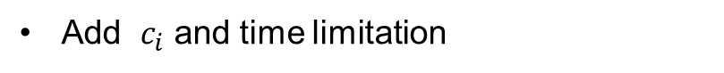
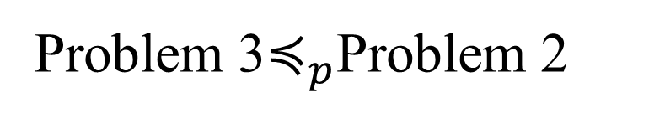
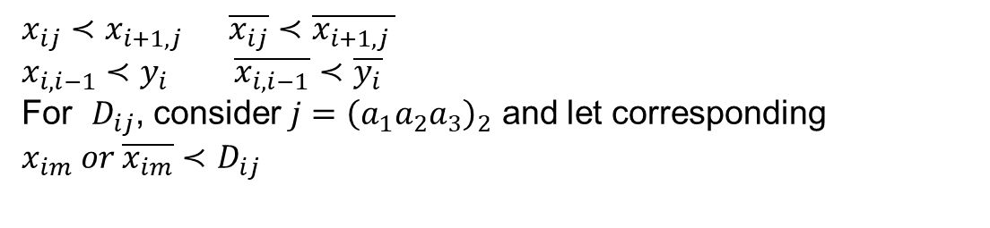
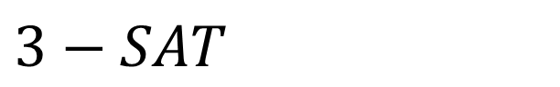
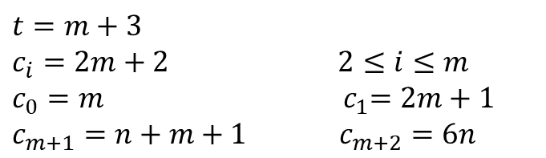
Problem Relationship
Problem 3$≼_{p}$Problem 2
Assume $m$ liberates and $n$ clauses
Problem 2
Construct tasks
$x_{ij}$,$\overline{x_{ij}}$ $1≤i,j≤m$
$y, \overline{y_{i}} 1≤i≤m$
$D_{ij} 1≤i≤m,1≤j≤7$
Tasks $n$
Processors $c_{i}$ at time $i$
Tasks partial order $≺$
Time limitation $t$
Each task executes a unit time
$∑_{i=0}^{t−1}c_{i}=n$
Construct partial order
$x_{ij}≺x_{i+1,j }$ $\overline{x_{ij}}≺\overline{x_{i+1,j }}$
$x_{i,i−1}≺y_{i}$ $\overline{x_{i,i−1}}$ $≺\overline{y_{i}}$
For $D_{ij}$, consider $j={\left(a_{1}a_{2}a_{3}\right)}_{2}$ and let corresponding
$x_{im} or \overline{x_{im}}$ $≺$ $D_{ij}$
Problem 3
$3−SAT$
Add $c_{i}$ and time limitation
$t=m+3$
$c_{i}=2m+2$ $2≤i≤m$
$c_{0}=m$ ${ c}_{1}=2m+1$
$c_{m+1}=n+m+1$ $c_{m+2}=6n$

Slide 17


03
Models

Slide 18
Models
Greedy
K-Greedy
1
2
Network-Based Fair
Network-Based Greedy
4
3

Slide 19
Overview
Greedy Approach:
Naïve and intuitive approach
K-Greedy Approach:
Make concessions
Network-Flow-Based Greedy:
Think at high level
Network-Flow-Based Fair:
Ensure max-min fairness
Notes:
Naïve, smarter, whole view, fair

Slide 20
Greedy
Intuitive approach
Assign task with shortest transferring time
$O\left(m log \left(\left|J\right|m\right)\right)$
Notes:
May worsen other

Slide 21
K-Greedy
Compromise approach
For task i, skip first k[i] assignments.
$O\left(Km log \left(\left|J\right|m\right)\right)$
Example
Notes:
Unnecessary compromise

Slide 22
Network-Flow-Based Greedy Approach
Consider k tasks simultaneously.
Build a network!
Compute maximum flow minimum cost

Slide 23
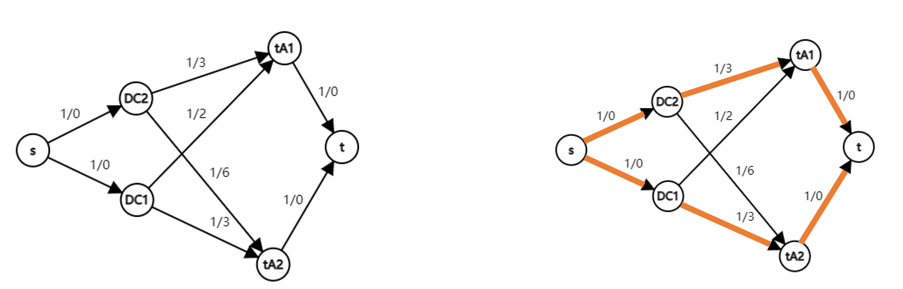
Network Example
$\left|J\right|m$ edges and $\left|J\right|+m$ vertices
$O\left(\left|J\right|m^{2}+{\left|J\right|}^{2}m\right)$
Tighter bound: $O(\left|J\right|m^{2})$
Notes:
More stable

Slide 24
Network-Flow-Based Fair Approach
Ensure max-min fairness.
Maximum flow with minimum $max⁡\{cost\}$
Certifier: Let $G(Δ)$ be the of edges with $cost≤Δ$
Use binary search to find bottleneck($Δ$).
Find bottleneck, update job group and repeat.
$O\left(\left(\left|J\right|m^{2}+{\left|J\right|}^{2}m\right)\log\left(cost_{max}\right)|K|\right)$

Slide 25
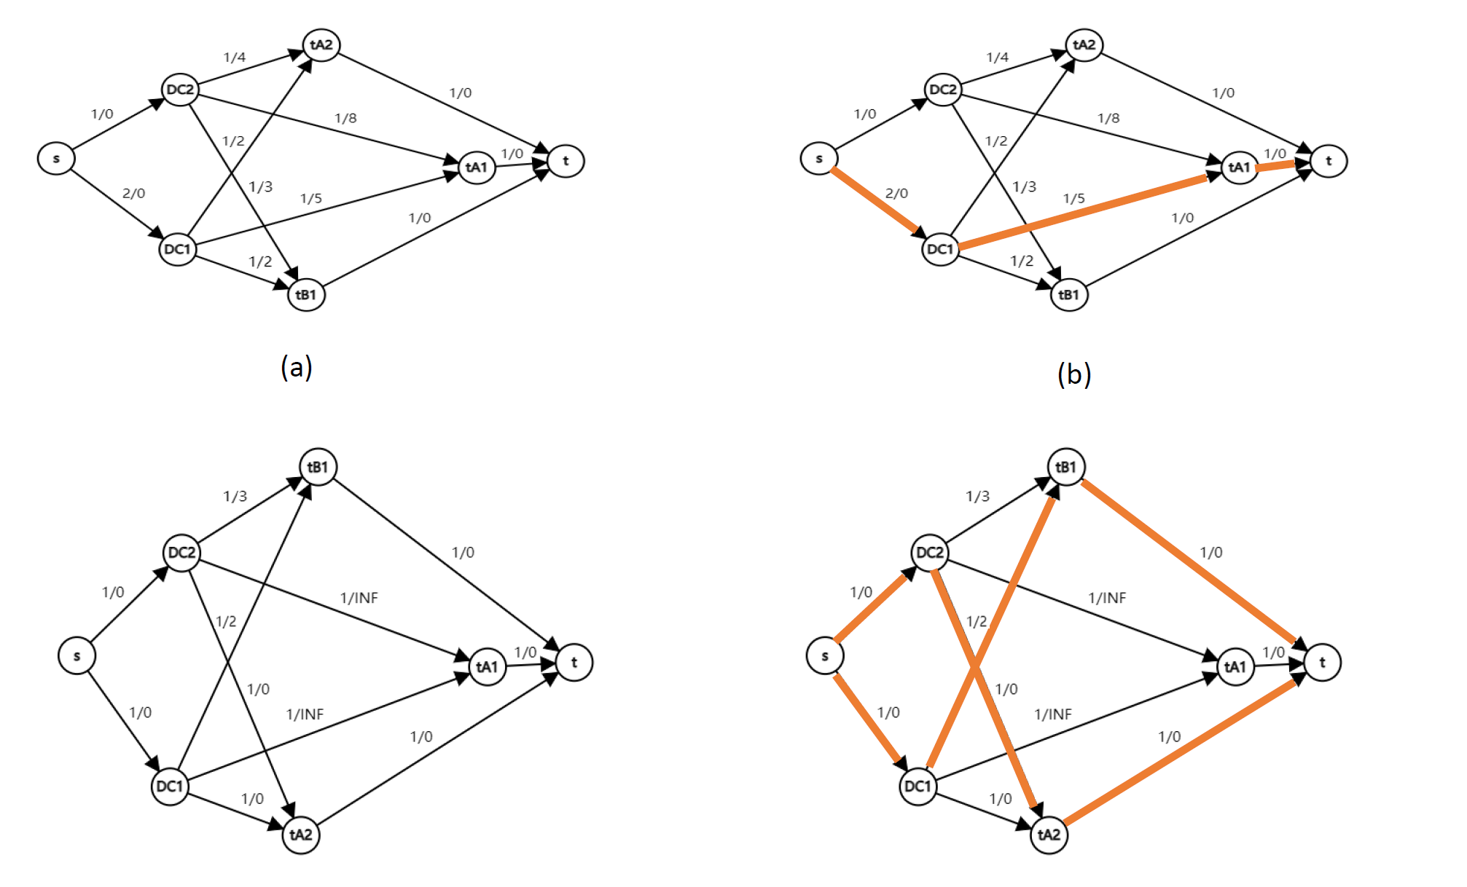
Network Example
Fair: (5,4,2)
Greedy: (5,2,3)
Notes:
More stable

Slide 26

Performance Analysis
04

Slide 27
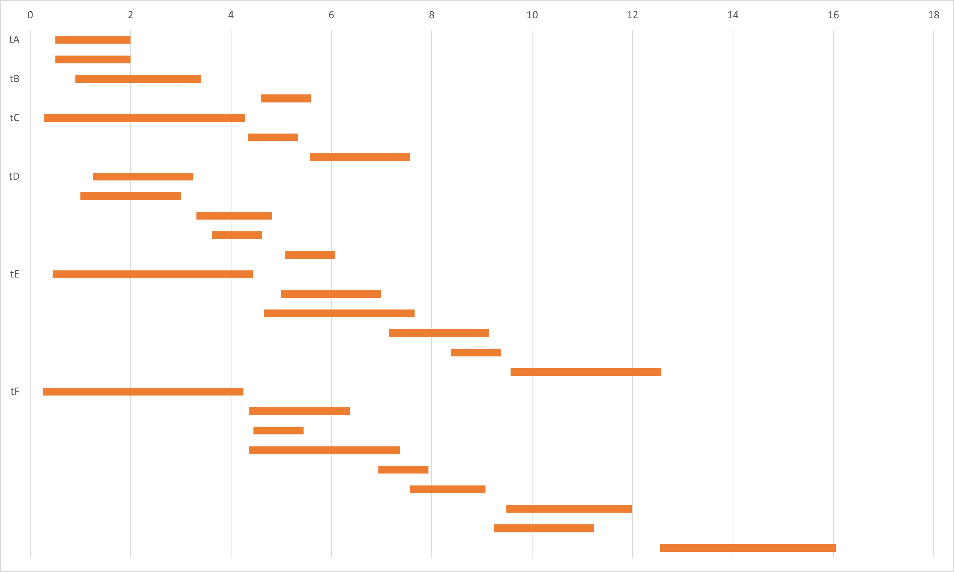
Optimal Solution of Toy Data
Property: Greedy yields optimal solution with $∞$ slots.
Toy data has relatively large slots in DC.

Slide 28
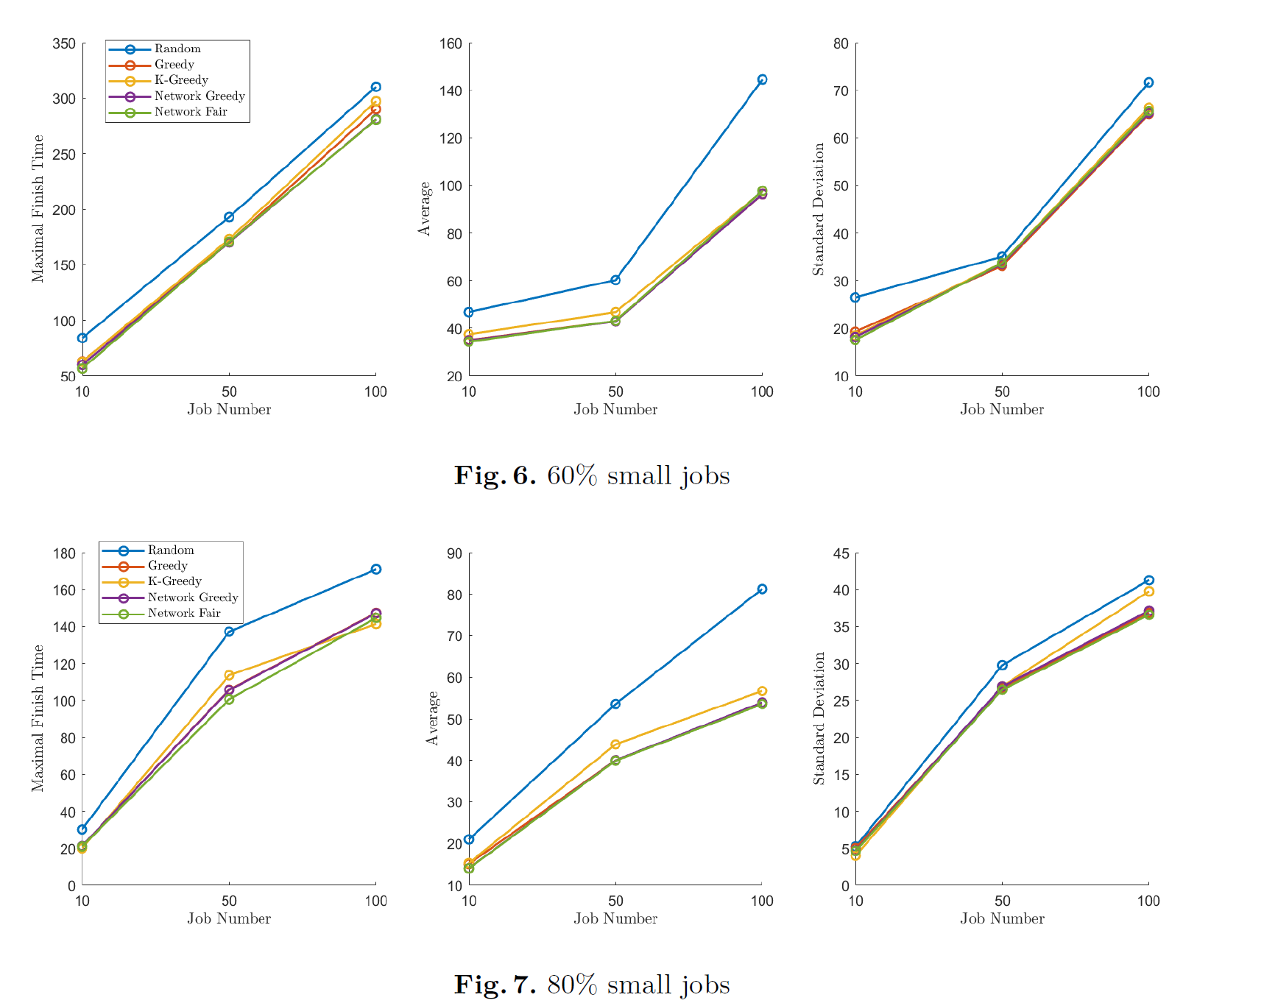
Performances Overview
Different job amount and different task duration

Slide 29
Performances Details
Basic Mathematic Characteristics of Performance
Methods | Average Time | Finish Time | Standard Deviation
Random Approach | 30.823 | 107.331 | 22.6757
Greedy Approach | 24.203 | 106.76 | 20.8664
k-Greedy Approach | 24.8509 | 114.503 | 22.8843
Network-Flow-Based Greedy Approach | 23.4635 | 90.35 | 19.2471
Network-Flow-Based Fair Approach | 23.6664 | 81.33 | 18.4392

Slide 30
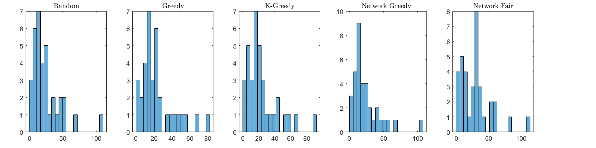
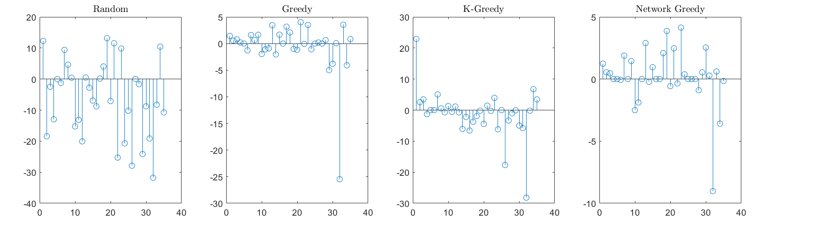
Performances Details

Slide 31
Thanks

